Slide 1


Social Buzz
Data Analysis
Notes:
Hello and welcome, my name is Erika Atoma and today I will be presenting to you the results of the Data Analytics task.

Slide 2


Today's agenda
Project recap
Problem
The Analytics team
Process
Insights
Summary
Notes:
Today's agenda will be as follows:
We will recap the overall project to give a high level understanding of the business problem we're tackling and the specific requirements.
We will dive into the specific problem that we, the Data Analytics team, have been focusing on and will give some background as to why this is such a big problem.
After introducing the problem, I will go over the team responsible from our side in tackling this task.
I will then go over the high-level process that we followed to complete this task, so that you have complete clarity in how we tackle these kinds of tasks.
Finally, I will go over the all important results and I will present them as a series of insights and visualization's from our analysis. To wrap up, I will summarize and open for any questions.

Slide 3

Social Buzz is a fast growing technology unicorn at needs to adapt quickly to it’s global scale.
Accenture data team runs a three month initial project focusing on these tasks:
An audit of their big data practice
Recommendations for a successful IPO
An analysis of their content categories that highlights the top 5 categories with the largest aggregate popularity
Project Recap
Notes:
To kick things off, let me recap this engagement.
We, Accenture have embarked on a 3 month pilot with Social Buzz to focus on 3 main tasks, aligned with some of the biggest challenges that you're currently facing.
Social Buzz has reached huge scale in recent years to become recognized as a global unicorn company. We are here to help you manage this scale and to guide you in the right direction.
Firstly, we will be doing an audit of your big data practice and sharing best practices and industry expertise. Secondly we will be guiding you through a successful IPO, of which we have deep expertise and knowledge of within our team. And finally, we have conducted an analysis of your data to find insights regarding your top 5 most popular categories of content

Slide 4

Problem
Over 100,000 pieces of content per day
36,500,000 pieces of content per year
But how to capitalize on it when there is so much?
Accenture team will analyze to find Social Buzz’s top 5 most popular categories of content.
Notes:
Focusing on the last point that I mentioned there, this is what the Data Analytics team has been specifically focused on.
Clearly with such grand scale, this comes with a lot of data and with such vast amounts of data comes challenges.
To give a background on how much data you've been creating:- You told us that your platform receives over 100000 posts per day which amounts to 36 500 000 posts every year, of which, this is all unstructured data making it very hard to make sense of.
In this dean age, content is king. Just look at some of the biggest platforms in the world, for example YouTube, Facebook and Netflix... they are all content businesses...
But how to capitalize on it when there is so much?
It's not just all about harvesting as much content as possible... The real value is in understanding and crunching this content to gain a deeper understanding of your audience and to therefore provide a more personalized and enjoyable experience.
And this is where out data analytics expertise comes in, with the insights that we've uncovered from this task, we can show you exactly how to take analytics to production at scale.

Slide 5



Andrew Fleming
Chief Technology Architect
The Analytics team
Marcus Rompton
Senior Principal
Erika Atoma
Data Analyst
Notes:
Talking about experience, we have a large data analytics practice at Accenture but we had a team of 3 people primarily focusing on this task. Andrew Fleming is our Chief Technical Architect and her expertise really helped to guide the team to produce high quality analysis.
Marcus Rompton, a senior principal has worked with the worlds biggest clients on solving their data problems and was heavily involved in the data engineering side of this project.
And finally myself, Erika Atoma, who was solely responsible for taking leadership guidance and delivering high quality insights from the raw datasets and turning these into business decisions.

Slide 6
Process
1
Data Understanding
2
Data Cleaning
3
Data Modelling
4
Data Analysis
5
Uncover Insights
Notes:
So, how did we tackle this problem?
Well we approached it in 5 steps:
Data understanding - the key to success on any data project is to understand the data in detail. So we took the time to understand the data model and domain of your business.
Data cleaning - after understanding your business, we then cleaned the available datasets and thought about what an ideal dataset should look like for this problem.
Data modelling - After ensuring the data was clean for analysis, we needed to process and model this data into a dataset that can precisely answer the business questions and produce the results needed.
Data analysis - With our new dataset, we used our analytical expertise to uncover insights from this dataset and to produce visualizations to describe the insights.
And finally we used these insights to unlock business decisions and to make recommendations on next steps.

Slide 7

Insights
1897
16
MAY 2021
REACTIONS TO “ANIMAL”
POSTS
UNIQUE
CATEGORIES
MONTH AND YEAR WITH THE MOST POSTS
Notes:
Take a look of the insights:
From your data we found that you had a total of 16 unique categories of posts across your sample dataset. This includes things such as Food, Science and Animals.
As well as this, there were 1897 reactions from just the animal category alone! People obviously really like animals!
And also the most common month for users to post within was May 2021. This aligns with seasonal trends of social media users that feel the need to reconnect with people after calendar events such as Christmas.
But now, onto the main question... which is... what were the top 5 most popular categories of posts?

Slide 8
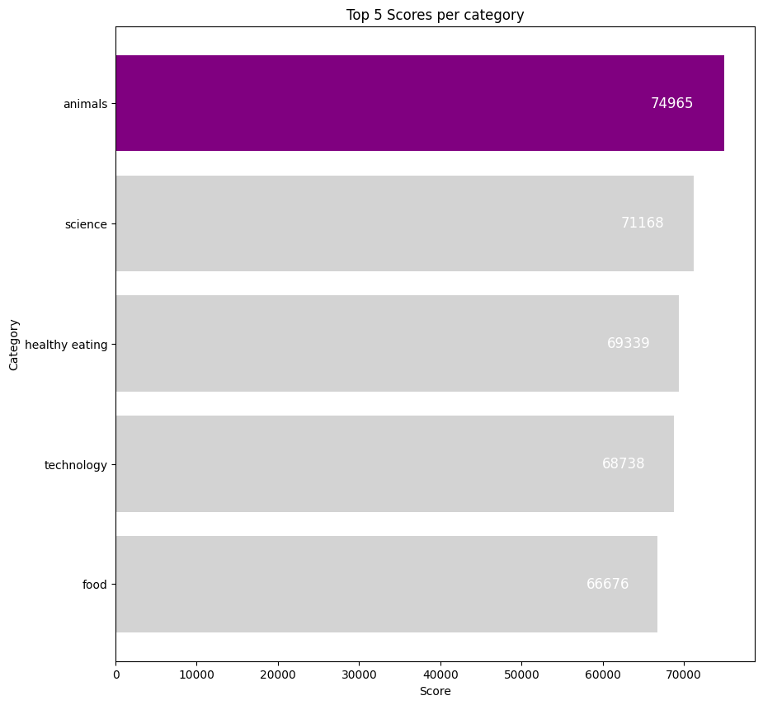
Animals and science drive highest content scores, which optimize for real-life themed posts
Notes:
From our analysis, you can see that the top 5 most popular categories of posts were animals, science, healthy eating, technology, and food in descending order.
Animals had an aggregate popularity score of around 74965. It is very interesting to see both food and healthy eating within the top 5, it really shows that food is a highly engaging content category. Healthy eating ranks slightly higher than food, so perhaps your user base may be skewed towards healthy eaters and health-conscious people.
Finally, its also interesting to see science and technology too. This may suggest that people enjoy consuming factual content and snippets of content that they can learn something from.

Slide 9
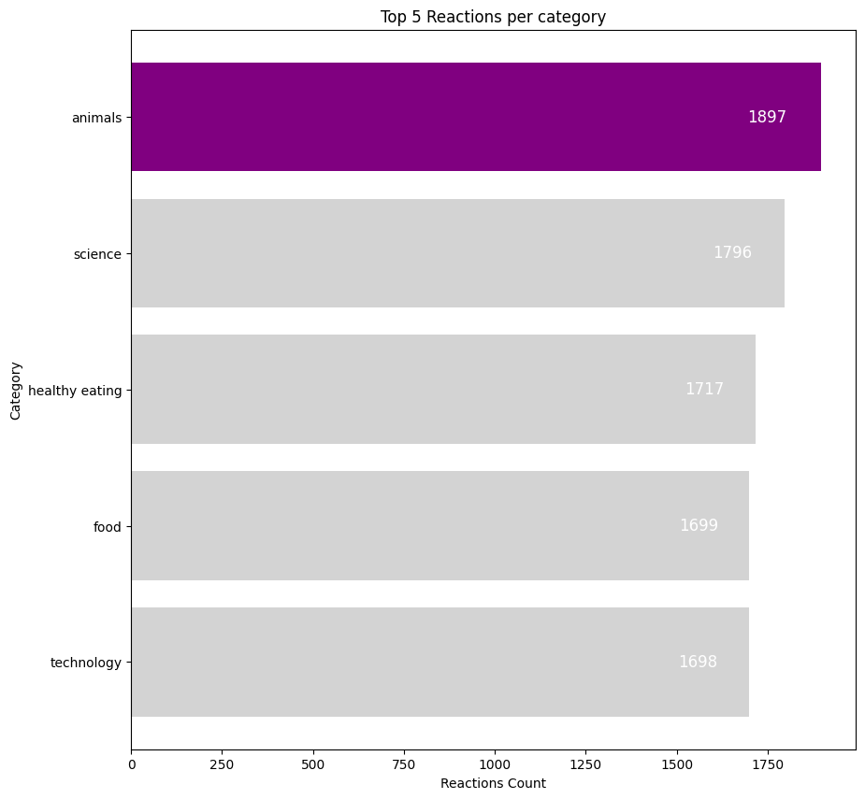
Animal posts generate 1,897 reactions, leading driver of user engagement
Notes:
From our analysis, you can see that the popularity of top 5 categories were animals, science, healthy eating, technology and food in descending order.
Animals had an aggregate popularity score of around 1897. It is very interesting to see both food and healthy eating within the top 5, it really shows that food is a highly engaging content category.
In business terms, this could suggest that the most popular category, animals, is tailing away from the rest of the categories and may continue to get more and more popular. To avoid an issue where one content category consumes the entire platform, it will be important for you to ensure that any algorithms used to govern the content on the platform gives a fair balance to the content categories.

Slide 10
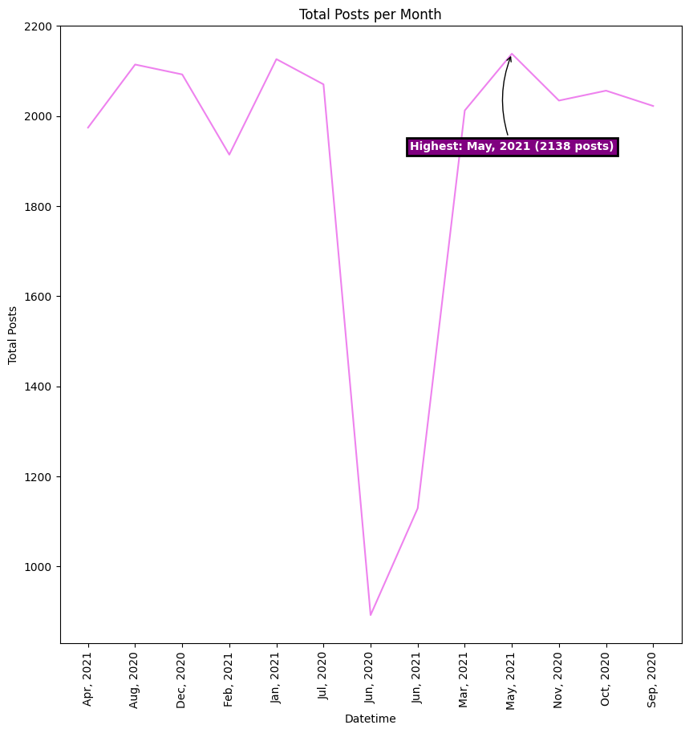
Content creation surged 35% in May 2021, monitoring similar spikes for campaign timing
Notes:
From our analysis, we can see that the content creation surged 35% in May 2021, mounting to 2139 posts. Therefore, we investigated which content was popular at that time to help refine our marking strategies using past successful marketing campaign at that season.

Slide 11
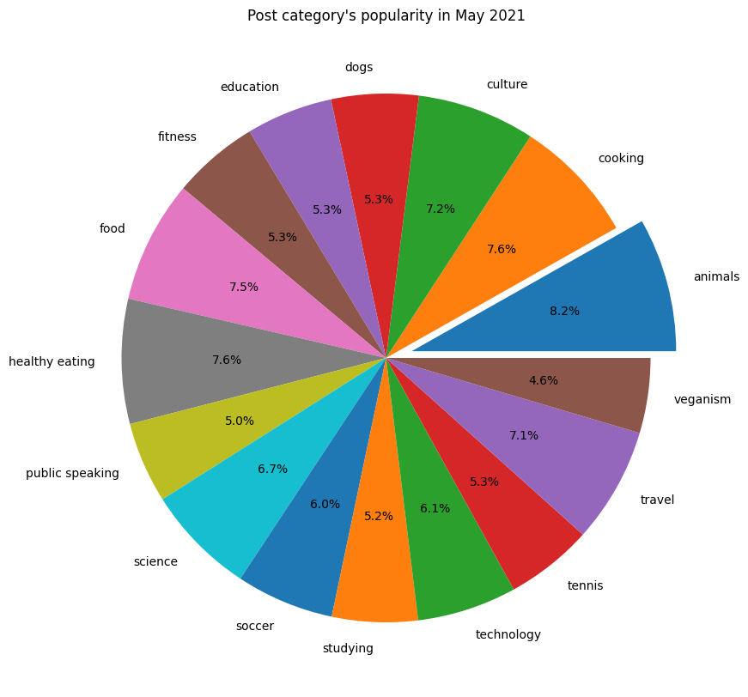
Lifestyle and real-life categories made up over 30% of peak-month content
Notes:
We can see that the animal, healthy eating, food, culture and cooking content categories tops the chart making up over 30% of the peak-month content.

Slide 12

Animals is the single most prominent content category on Social Buzz, achieving the highest aggregate popularity score of any category. The animal-related posts slightly outperformed the next most popular topic (Science), highlighting a broad user fascination with animal content (e.g. pet videos, wildlife images). The people enjoy “real-life” and “factual” content the most.
The platform’s posting activity has grown over time, culminating in a surge of content in May 2021. In that month, Social Buzz saw its highest-ever volume of user posts (~2,138 posts).
“Healthy Eating” is a common theme with the top 5 categories with “Food” and “Cooking”. The users gravitated toward content about personal lifestyle and real life (from home cooking recipes to fitness and nutrition posts). This may give an indication to the audience within your user base.
You can create campaign and work with healthy eating brands to boost user engagement.
This ad-hoc analysis is insightful, but it’s time to take this analysis into large scale production for real-time of your business. We can show you how to do this.
Summary
Notes:
So to summarize: We tackled this task and found the top 5 most popular categories as asked, but we also went one step further.- We found that animals and science are the two most popular categories, suggesting that users like "real-life" and "factual" content- We also found that food was a common theme amongst popular content and the most popular food category was healthy eating. This could be a signal to show the types of people that are using your platform, and you could use this insight to boost engagement even further. For example, you could run a campaign with content focused on this category or work with healthy eating brands to promote content.- As much as this analysis was insightful, we are ready to take it to the next stage and we have the expertise within Accenture to help you realize these kinds of insights in production across your organization and in real-time. We would love to help you with this.
Social Buzz should consider deploying production-level tools (such as live dashboards and automated trend detection algorithms) that continuously monitor content category performance and user reactions in real time. By doing so, the company can spot emerging trends (e.g. a sudden rise in a category like “cooking”) and respond immediately – whether by surfacing more of that content, refining recommendation algorithms, or informing marketing and content moderation strategies.
Embracing real-time content analytics will enable proactive management of user experience on the platform. As Social Buzz prepares for its IPO and the next phase of growth, demonstrating this capability is strategically important. It not only shows that the company understands its users’ preferences deeply, but also that it has the technical agility to leverage big data insights in driving engagement and monetization.

Slide 13

Thank you!
ANY QUESTIONS?

